Slide 1

BCS786 – Major Project Phase – II Paper Drafting – IEEE Conference
29th July, 2026

Slide 2

https://ieeexplore.ieee.org/Xplore/home.jsp

Slide 3
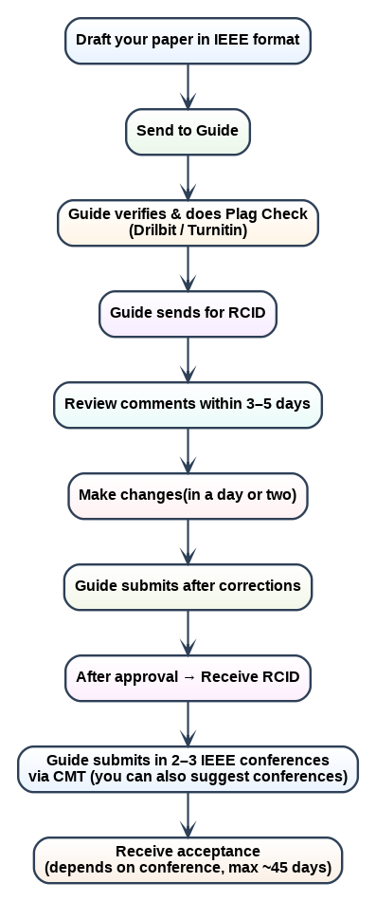
Steps to be followed
Duration:
RCID (College Level Review) - Max. 10 days
Conference Acceptance - Max. 45 days
Important Dates
IEEE Conference Draft Paper with RCID - 31/08/2026
Submission to IEEE conference - 14/09/2026
Registration Screenshot from conference - 28/10/2026

Slide 4
Financial Support for Publication by
CMRIT

Slide 5
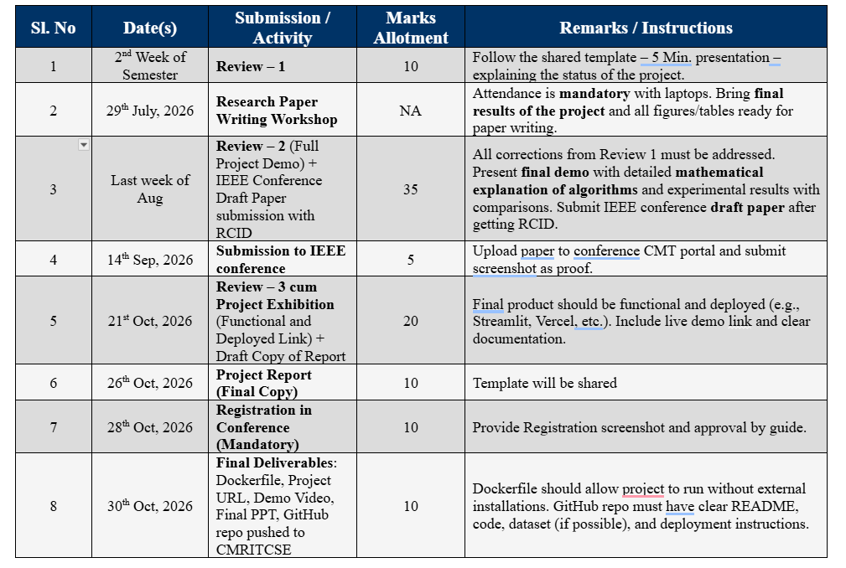

Slide 6
Types of Major Projects
IEEE Conference Paper should be Research Paper Only
Research Project
Application Project
Product

Slide 7

Registration

Slide 8
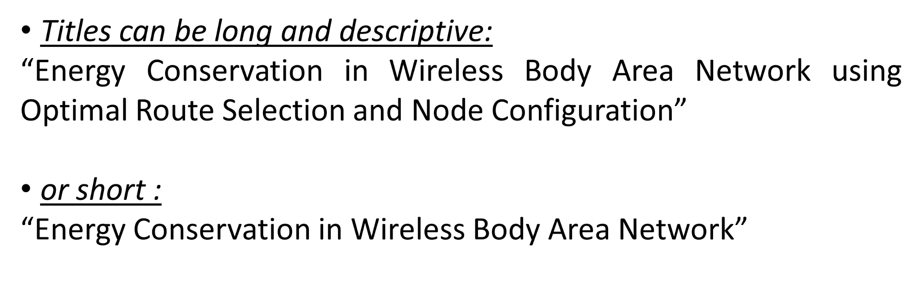
Deciding the Title of the Paper

Slide 9
Attendance System
Deep Learning Based Smart Attendance System Using Face Recognition

Slide 10
Few Examples
Deepfake MRI Detection: A ViViT-Based Landmark Feature Extraction Approach for Brain Tumor Scans
Attention-Enhanced Vision Transformer Model for Precise Skin Cancer Detection

Slide 11

Group Activity
https://docs.google.com/document/d/1zaOJ-DulkallteErqhO5Ok4Bry59dz4V3NTR9z4BWdw/edit?tab=t.0

Slide 12
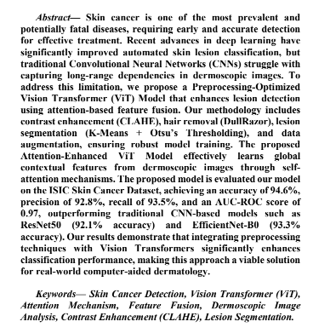
Abstract (Structure)
Abstract structure is as follows:(the sentence should not be complex, it should be simple) – 150 to 160 words.
Sentence 1: Introduction
Sentence 2: Problem Statement(drawback of the existing system)
sentence 3: solution for mentioning the Proposed algorithm
Sentence 4: details about the proposed system.
sentence 5: advantages of the proposed system over existing algorithms. (Novelty of the proposed system)
Sentence 6: Performance metric used to evaluate the proposed system, and 1 or 2 values.

Slide 13
Novelty in Algorithm (Very Important)
Novelty in a conference paper =
Tweaking an existing algorithm → e.g., modify architecture, parameters, loss function, or preprocessing.
Hybrid methods → e.g., combining two or more models/approaches.
Mathematical modifications → e.g., new equations, adaptive thresholds, custom loss, optimization strategies.

Slide 14
Introduction (Structure)
Paragraph 1: Application domain/ large domain introduction
Paragraph 2: Problem statement
  What is the existing system
  What is the drawback/issues facing by the existing system
Paragraph 3:
  What are the issues that will be addressed(Objectives of your project – but don’t mention in bullets write as a paragraph)
  Explain in brief the proposed system and highlight the novelty(Very important)
Paragraph 4:
  Organization of the paper.
Sample: https://drive.google.com/file/d/1OYOKeHowdRByJ3l5IDTC1mHLZL2KakBU/view

Slide 15
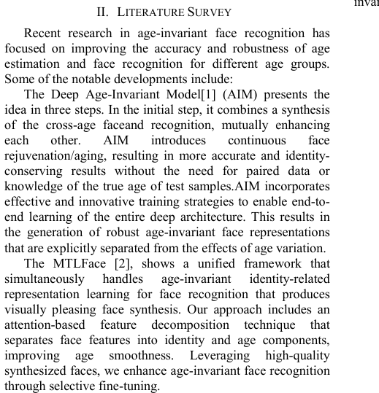
Related Works/ Literature Survey
Don’t use bullets or numbering, you can have each section as a different paragraph with running words. Don’t give subheadings or subtitles in the survey.

Slide 16
E - Resources
http://203.201.63.46/library/e_resource.html
or
User Remote Access URL: https://access.vtuconsortium.com/cmrit
Login ID: Institutional mail ID
Password: vtu@123 (later on, you can change your password.)
If you are using the college internet connection, then you need not login.
Base Paper and reference Papers should be from Journals only; not conferences, Preferably from publishers like
IEEE
Springer
Elsevier
Taylor & Francis
AMC etc..

Slide 17
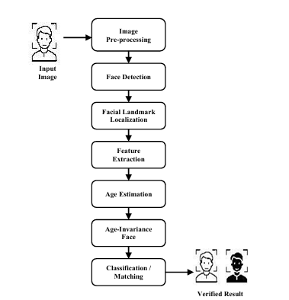
Proposed Methodology
Paragraph 1: Summarize the proposed methodology in three to five lines,
Divide your Proposed Methodology into 3 to 5 modules not more than that.
Have a Block Diagram and call that.

Slide 18
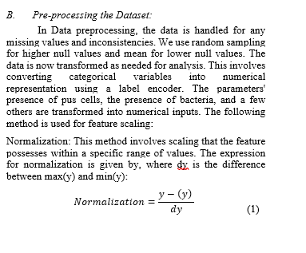
Proposed Methodology
Subheading 1: Module 1
  Explain
  Write Mathematical Equation

Slide 19
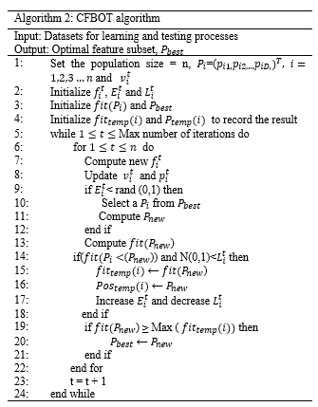
Proposed Methodology
Subheading 2 : Module 2
  Explain
  Algorithm/ Pseudo code

Slide 20
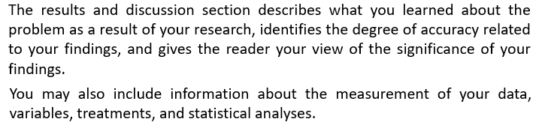
Results and Discussion

Slide 21
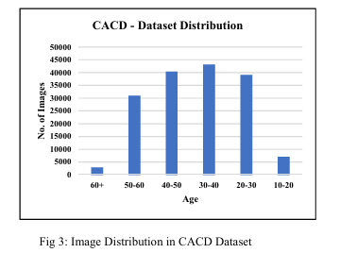
Results and Discussion
Subheading 1: Dataset:
  Explain the source of the dataset
  Description of the dataset
  Can have sample images as a grid
Label | Attribute | Type | Description
A₃ | age | Numerical | Age in years
A₄ | sex | Nominal | Gender of the patient: 0:female, 1:male
A₉ | cp | Nominal | Type of chest pain: 1: typical angina, 2: atypical angina, 3: non-anginal pain, 4: asymptomatic
A₁₀ | trestbps | Numerical | Resting blood pressure (in mm Hg)
A₁₂ | chol | Numerical | Serum cholesterol in mg/dl
A₁₆ | fbs | Nominal | Fasting blood sugar>120 mg/dl: 0:false , 1:true
A₁₉ | restecg | Nominal | resting electrocardiographic results: 0: normal, 1: having ST-T wave anomaly, 2: showing feasible or definite left ventricular hypertrophy by Estes' criteria
A₃₂ | thalach | Numerical | Maximum heart rate
A₃₈ | exang | Nominal | Exercise-induced angina: 0: no, 1: yes
A₄₀ | old peak | Numerical | Depression induced by exercise relative to rest
A₄₁ | slope | Nominal | The slope of the peak exercise segment: 1: up sloping, 2: flat, 3: down sloping
A₄₄ | ca | Numerical | Number of major vessels colored by fluoroscopy that ranged between 0 and 3
A₅₁ | thal | Nominal | 3: normal, 6: fixed defect, 7: reversible defect
A₅₈ | num | Nominal | Diagnosis classes: 0: no presence, 1: least likely to have heart disease, 2 to 4:More likely have heart disease

Slide 22
Results and Discussion Cont…
Subheading 2: Experimental setup:
  Mention your minimum system requirement or the libraries used etc.
  Don’t use a table, explain in running words

Slide 23
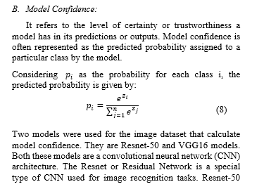
Cont…
Subheading 3: Performance Metrics:
  Minimum 5 metrics
  Let each metric be a Subheading.
  Write the definition
  Formula for calculating the metric
  Table and graph for each metric by comparing with 3 or 4 existing methodology.

Slide 24
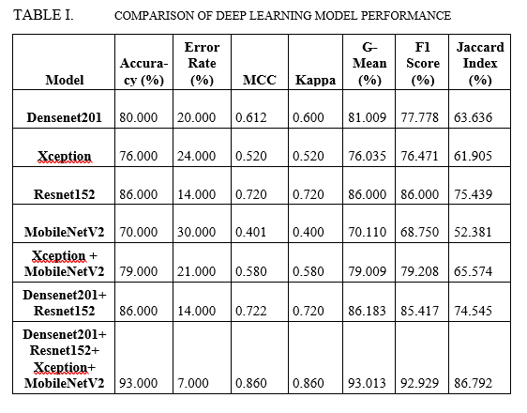
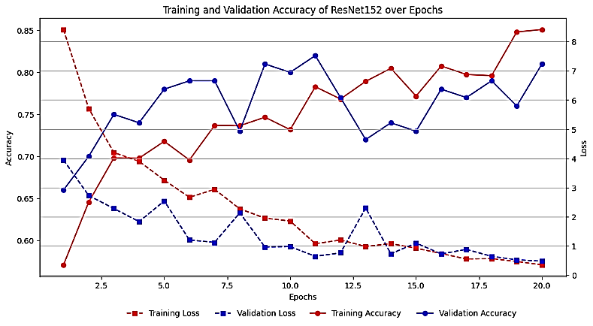
Sample Graphs and Tables

Slide 25
Conclusion and Future Work
Summarize your methodology
Highlight how the objectives were met using the proposed methodology
Quantitatively mention the evaluation metric values.

Slide 26
References
Minimum 15
IEEE Format:
  Refer simply to the reference number, as in [3]—do not use “Ref. [3]” or “reference [3]”
  G. Eason, B. Noble, and I. N. Sneddon, “On certain integrals of Lipschitz-Hankel type involving products of Bessel functions,” Phil. Trans. Roy. Soc. London, vol. A247, pp. 529–551, April 1955. (references)
You should include at least 3 citations from CMRIT publications.
Open the following link: All CMRIT Publications.
Search the sheet using keywords related to your paper title.
Copy the required titles and click on “Cite” to get the reference details.
Use these details in your reference section.

Slide 27
Plagiarism
Drillbit
Turnitin
AI Score and Similarity should be less than 10%
Tip: Rephrase the AI generated content to reduce AI score

Slide 28
Conference Details
Search For IEEE Conference

Slide 29
Templates
IEEE Manuscript Templates for Conference Proceedings : https://www.ieee.org/conferences/publishing/templates

Slide 30
Sample IEEE Conference Papers
https://drive.google.com/file/d/1OYOKeHowdRByJ3l5IDTC1mHLZL2KakBU/view?usp=sharing
https://drive.google.com/file/d/1bLYhJLuQnnq8F5h7Sj06hbEtScmWTYdi/view?usp=sharing
https://drive.google.com/file/d/1goNRUYbEOoHebPu5zAVMWDuDuoNSJQbP/view?usp=sharing (Student Paper)

Slide 31

Feedback

